Slide 1
ECOX5004 Economic Policy Analysis & Evaluation
Presentation Title: Assessing the impact of education on GDP output per capita across European nations
Name: Jack O’Callaghan

Slide 2
What we are looking for when grading your ability to..
Briefly introduce your Policy Question. You're looking at the Impact of MWs (in what form?) ON which Y(?)
Describe and convey the importance of your question succinctly.
Present your (preliminary) results in a clear and succinct way
Describe the weaknesses and problems in these results (e.g., Measurement problems, omitted variables etc)
Justify a plan for an alternative estimation strategy that can address some of these problems, if you have attempted this, present preliminary results too
Do not worry about the ‘quality’ of your estimate, what matters is the care with which your report your results,
if you’re confident a result is good, then tell us so and briefly say why you think that
if you think the result is weak, or should not be trusted, then state why and be sure not to over-claim it’s importance!

Slide 3
To Recap, My Question is:
Does an increase in the average number of years of education lead to an increase in a country’s per-capita output-side real GDP in US Dollars?
This question is crucial to policymakers when appraising the economic impact of education policy options, for example potential regulatory changes to the minimum number of years citizens must spend in full-time education.
For my baseline model, my X (policy) variable is average number of years of education and my Y (impact) variable is per-capita output-side real GDP.
My dataset joins data from World Bank, Barro & Lee, and Penn World Tables.

Slide 4
Variable Definitions
Variable | Description | Units | Source
rgdpo.pop | Real GDP Output per Capita | 2017 US$ | Penn World Tables 10.01
log.rgdpo.pop | Natural log of real GDP output per capita | 2017 US$ | Penn World Tables 10.01
year_orig | Years since 1970 | Years | Penn World Tables 10.01
yrs_sch | Average number of years of education | Years | Barro & Lee
voc | Share of all students in secondary education enrolled in vocational programmes (binary: above EU average 0/1) | Numerical Factor | World Bank
gen | Gender ratio for average years of schooling (binary: above European average 0/1) | Numerical Factor | Barro & Lee
avh | Average annual hours worked by persons engaged (employed) | Hours | Penn World Tables 10.01
csh_x | Share of merchandise exports at current PPPs | Numerical Factor | Penn World Tables 10.01
fdi | Foreign Direct Investment (FDI), net inflows as a share of GDP | % of GDP | World Bank
ctfp | TFP level at current PPPs (USA=1) | Numerical Factor | Penn World Tables 10.01

Slide 5
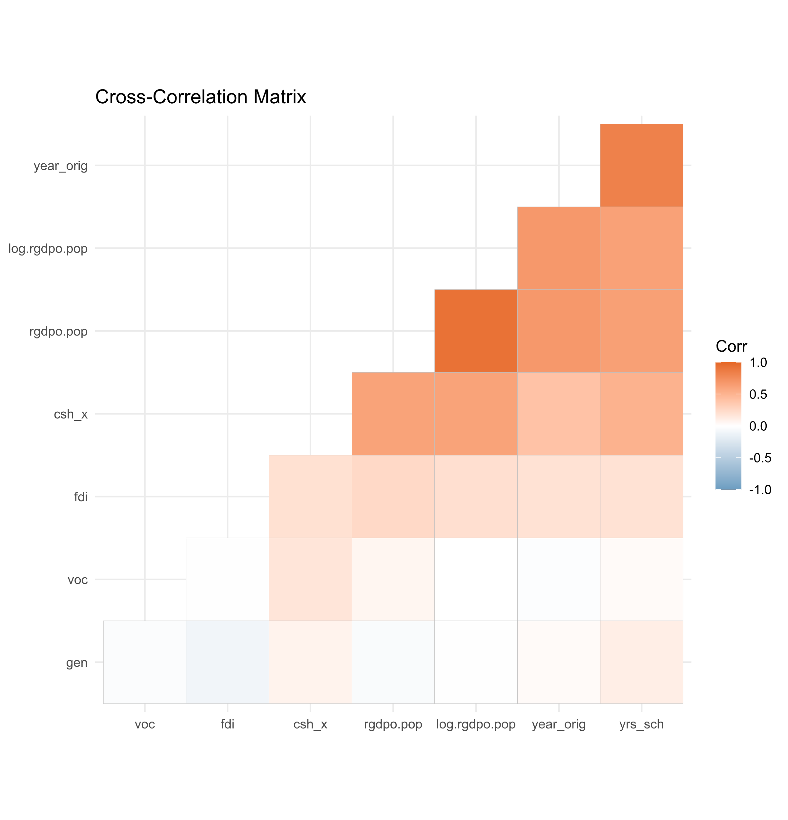
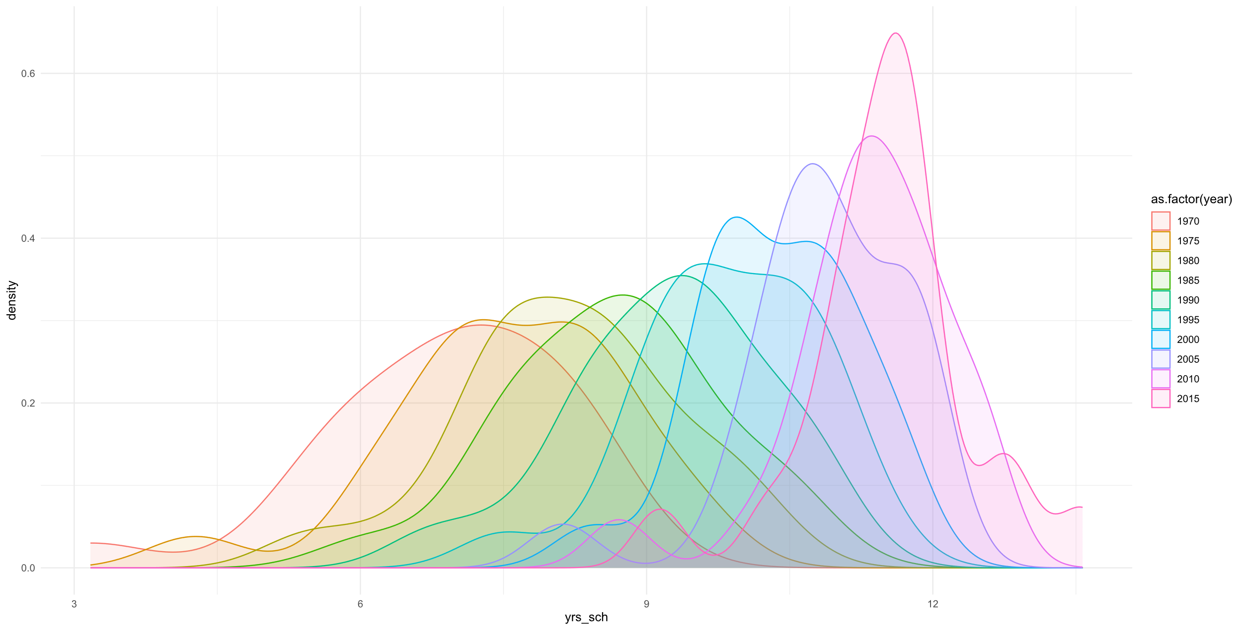
Summary stats for the data used
Looking first at the density plot, we can see that years of education (yrs_sch) has a singular modal value for most years. The data also seems to be becoming more leptokurtic over time, implying that while years in education has been increasing over time, the difference in this figure between different countries has also been declining. Upon visual inspection, there is very little skew to this data.
As one might expect, real GDP output per capita and the log-transformed version are highly correlated.
Both versions of the real GDP output per capita variable are highly correlated with both number of years since 1970 (year_orig) and years of education (yrs_sch).
Variable | Minimum | 1st Q. | Median | Mean | 3rd Q. | Maximum | Standard Deviation
rgdpo.pop | 3,002.00 | 15,534.00 | 23,531.00 | 25,538.00 | 33,447.00 | 82,382.00 | 14,031.57
log.rgdpo.pop | 8.01 | 9.65 | 10.07 | 9.99 | 10.42 | 11.32 | 0.60
yrs_sch | 3.17 | 8.16 | 9.64 | 9.45 | 10.93 | 13.57 | 1.84
avh | 1,401.00 | 1,627.00 | 1,766.00 | 1,778.00 | 1,903.00 | 2,334.00 | 207.67
csh_x | 0.00 | 0.16 | 0.27 | 0.34 | 0.49 | 1.22 | 0.24
fdi | -15.71 | 0.58 | 1.95 | 10.36 | 5.39 | 340.26 | 31.16
ctfp | 0.45 | 0.76 | 0.87 | 0.88 | 0.98 | 1.44 | 0.18

Slide 6
Results from your first estimation
rgdpo.pop = const + B1·year_orig + B2·yrs_sch + B3·voc
rgdpo.pop = const + B1·year_orig + B2·yrs_sch + B3·voc + B4·ctfp
 | Coefficient | Std. Error | t-ratio | p-value
const | −934.22 | 4994.95 | −0.19 | 0.8518
year_orig | 507.57 | 87.72 | 5.79 | <0.0001 | ***
yrs_sch | 1488.12 | 684.63 | 2.17 | 0.0309 | **
voc | 1973.48 | 1409.87 | 1.40 | 0.1631
 | Coefficient | Std. Error | t-ratio | p-value
const | −26984.10 | 5159.49 | −5.23 | <0.0001 | ***
year_orig | 463.97 | 75.62 | 6.14 | <0.0001 | ***
yrs_sch | 1572.45 | 585.18 | 2.69 | 0.0078 | ***
voc | 1606.11 | 1209.39 | 1.33 | 0.1857
ctfp | 30130.70 | 3359.27 | 8.97 | <0.0001 | ***
Model | R² Value | Adj. R² Value | Durbin-Watson | Durbin Lower | Durbin Upper | White’s Test
Model 1 | 0.482 | 0.475 | 1.636 | 1.61 (k=4) | 1.74 (k=4) | 0.000013
Model 2 | 0.621 | 0.614 | 1.702 | 1.59 (k=5) | 1.76 (k=5) | 0.000000

Slide 7
Discussion of your results
Starting with the adjusted R² values, Model 1 had an adjusted R² value of 0.475 and Model 2 a value of 0.614, meaning that both models explain a high proportion of the variance in the impact variable, and that the initial model specification is likely broadly sensible.
Ignoring model constants, all model predictor variables were statistically significant, except for voc, which is a binary variable which controls for if the prevalence of vocational education in a country is above the EU average. The variable voc has a p-value of 0.16-0.19 across the two models, meaning that while this variable is not statistically significant at the 10% significance level, it may still be useful to include this variable when controlling for qualitative differences in education by country.
Looking first at Model 1, we can see that there is a positive economic relationship between number of years of education and GDP output per capita, when controlling for differences in type of education (voc) and changes in productivity over time (captured indirectly with year_orig). To ease interpretation of the model, we used year_orig, which is the number of years since the base year 1970, to avoid having a large negative constant in this model.
Looking at model 2, the addition of productivity variable ctfp led to some change in the size of other coefficients, but (ignoring the constant) all remains within one standard error of their original estimate. While the addition of ctfp increased the adjusted R² and model p-value, the scale of this coefficient reduces overall model interpretability, and as such it may also be useful to consider adding in Instrumental Variable such as average hours worked to examine how this impacts the existing parameter estimates.
The Durbin-Watson test statistic for each model both fall within the zone of indecision, although both are very close to the Durbin lower bound. As such, at the 5% significance level we do not have sufficient evidence of autocorrelation and will not be adding a lagged variable to the model. Given the limited sample size this model analyses for each country (10 half-decade data points between 1970 and 2015), it would be impractical to include a lagged variable regardless. However, a future study with more data points may be able to better examine a lag between increased education and higher GDP output per capita.
We also performed a White’s test for heteroscedasticity for both model, and both had p-values of less than 0.01, meaning that we may reject H₀, as heteroscedasticity is present in the data. We will log-transform the rgdpo.pop variable to see if this better models the relationship between number of years in education and GDP output per capita.
At a later stage, we will build on these initial models, using Breusch-Pagan LM and Hausman tests to consider if a Fixed Effects model might be more appropriate than a pooled OLS model for this panel data.
While these initial models might help to make some early inferences into the relationship between education and GDP output per capita, there are some important caveats to note. Firstly, pooled OLS does not account for country-specific or time-specific effects. That is, the marginal return of an additional year of education might be different, for example, between Norway and Poland, depending on factors such as the existing number of years of education and the quality of educational training in terms of improving GDP output within a country.

Slide 8

Your plan for the next steps
Upon inspection of initial modelling, there were a few key problems to address. Firstly, we found evidence that heteroscedasticity is present in the data. We will attempt to resolve this by log-transforming our Y (impact) variable to account for possibly diminishing marginal returns to scale to an additional year of education as education increases.
Secondly, there are some questions left unresolved relating to model structure. Given the panel structure of this data and the differences in initial GDP output per capita, it might be the case that a Fixed Effects model might be more appropriate than the initial pooled OLS approach. We will build an equivalent Fixed Effects model and use the Hausmann and Breusch-Pagan tests to examine the appropriateness of a Fixed Effects model for this data.
Finally, we will add average hours worked as an instrumental variable, to see how this interacts with our parameter estimates of total factor productivity.

Slide 9
Suggestions for future work
The biggest challenge with my analysis to date relates to data gaps. In a practical sense, this has forced me to choose between variable imputation (such as Foreign Direct Investment, see technical annex) where the number of gaps is very small, or narrowing the scope of the analysis (see countries removed due to significant data in the technical annex).
It is possible that with more research and time to arrange access permissions, I would have been able to source alternative or estimated data, reducing the need to exclude countries. This would likely improve the generalisability of the findings of this analysis.

